Slide 1
Din Rail Meter
Transfopower

Slide 2
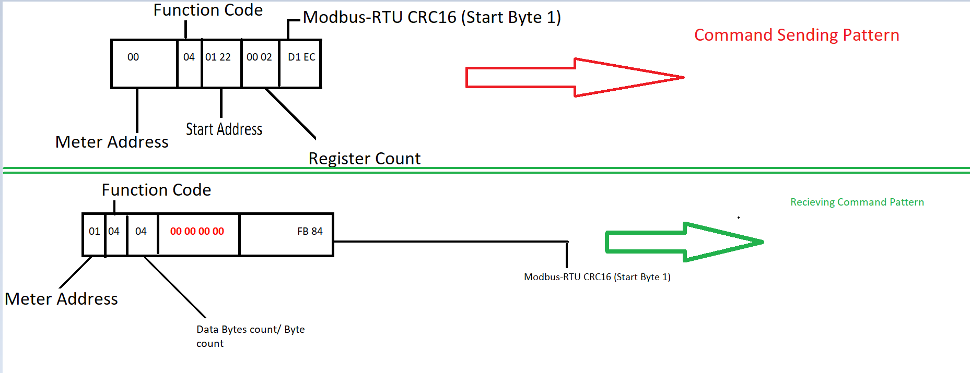
Protocol Understanding

Slide 3
What is done so far?
Backend Routing
All Commands Send/Receive given in the protocol Document.
Front end (User Management , Load Profile ,Voltages Tab)
Load profile/Voltages/currents (On Demand)

Slide 4
What is left
Multiple Meters Connection Handling
Backend Load profile/Voltages/currents Graph
Load profile/Voltages/currents (On Schedule)
CRC Parity check
Enhanced Exception Handling
Load Testing

